Slide 1

Image Restoration with Diffusion Model
Capstone Project Phase A
24-2-R-5
Roi Darom
Hagar Tibi
Supervisors: Dr. Renata Avros & Prof. Zeev Volkovich

Slide 2
Purpose of the project
The methodology developed to repurpose camouflaged object detection using diffusion models is going to be applied and extended for restoring and enhancing the quality of damaged images (particularly medical).
Notes:
So let's start with the פורפס of our project. Our project deals with the repurposing of a camouflaged object detection model using diffusion model and extends this method to restore damaged images and refine them.
The datasets we will work with consist mainly of MRI images (medical images)

Slide 3
What is Camouflage ?
Camouflage is the phenomenon where an object naturally blends into its environment, making it less noticeable to observers.
Camouflaged object detection is challenging due to the high visual similarity between the object and the background.
The problem is crucial in various fields like military, medical imaging, and wildlife monitoring.
Notes:
Camouflage is the פנומנון where an object naturally blends into its environment, making it less noticeable to the viewer.Detecting camouflaged objects is challenging due to the high similarity between the object and its background, which is אסנישל in various fields such as the military, medical imaging and wildlife monitoring.

Slide 4
Introduction to diffCOD Framework
Diffusion Models: Approach COD (Camouflaged Object Detection) as a denoising process
Training Process: The model learns to recognize objects within noised images using the reverse diffusion process
Key Component: Injection Attention Module (IAM) enhances the denoising capability
Notes:
A brief overview of the framework for using diffusion models in the detection of camouflaged objects.The main idea is to treat CODas a denoising process,where the model learns to transform the noise that is added to the image during training.A crucial component of this process is the injectionattentionmodule,which significantlyimproves the model’sabilitytodenoise.
Roi will provide a more detailed explanation of these concepts in a few slides
When I refer to "diffCOD," I am using it as a shorthand for Diffusion Camouflaged Object Detection. Hereafter, I may use either term alternately, but both refer to the same concept.
Gruond truth – רקע שחור , עצם לבן , מיקוד באוביקט הלבן

Slide 5
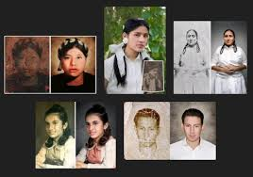
Image Restoration Overview
Process:
Reconstructing images degraded by noise, blurring, or timing
Challenges:
Deal with various types of distortions
Parts of the image may be missing and going to be restored
Notes:
Image restoration involves recovering images that have been degraded by noise or blurring with the goal of returning them to their original state. Process:Noise Reduction: Removing unwanted variations that make the image look grainy.Deblurring: Sharpening images that blurred by focus issues.Challenges:Different Types of Noise: Each type, such as Gaussian or salt-and-pepper noise, requires specific techniques.Complex Blurring: Various causes of blurring need different approaches.Loss of Information: Some parts of the image may be missing, requiring advanced methods for reconstruction.

Slide 6
From COD to image restoration
Using diffusion models for image restoration.
Both tasks (COD, Restoration) focus on noise transforming or recognition of hidden and not observed data
The same principles that help detect hidden objects can be applied to restore and enhance damaged images.
Notes:
how can we apply diffusion models for image restoration?The core idea here is that both image restoration and camouflaged object detection share a common goal: transforming noisy data into clear, refined outputs. Just as diffusion models can reveal hidden objects by denoising complex visual patterns, the same principles can be applied to restore images that have been degraded by noise or blurring, or other distortions.so,by leveraging the strengths of diffusion models, we can enhance the quality of degraded images in much the same way that we use them to detect hidden objects

Slide 7
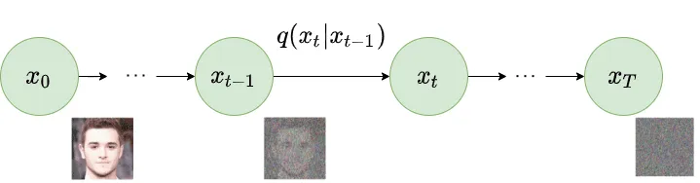
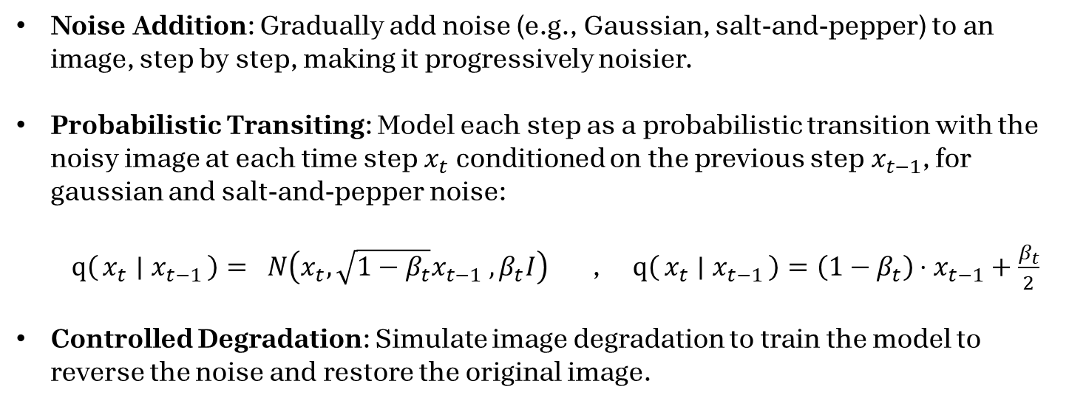
Forward DIFFUSION process
Noise Addition: Gradually add noise (e.g., Gaussian, salt-and-pepper) to an image, step by step, making it progressively noisier.
Probabilistic Transiting: Model each step as a probabilistic transition with the noisy image at each time step$x_{t}$​ conditioned on the previous step$x_{t−1}$​, for gaussian and salt-and-pepper noise: $q\left(x_{t} ∣ x_{t−1}\right)= N\left(x_{t}, \sqrt{1−β_{t}}x_{t−1} ,β_{t}I\right)$ , $q\left(x_{t} ∣ x_{t−1}\right)=\left(1−β_{t}\right)⋅x_{t−1}+\frac{β_{t}}{2}$
Controlled Degradation: Simulate image degradation to train the model to reverse the noise and restore the original image.
Notes:
In this slide, we are focusing on the process of image degradation through noise addition and how it can be modeled using a diffusion process. we start with a clean image and then gradually add noise to it, step by step. For example, we could use Gaussian noise or salt-and-pepper noise.
Each step makes the image noisier, simulating what happens in real-world scenarios where images get damaged due to various factors.
We treat this process as a probabilistic transition, where the noisy image at each time step, denoted as xt​, is conditioned on the noisy image from the previous step, xt−1​. For Gaussian noise, we represent this transition using a normal distribution. The idea is that the noisy image xt depends on xt−1​ in such a way that each subsequent image gets progressively noisier according to the amount of noise defined by a parameter, βt.
This controlled degradation is crucial for training the models, By simulating how an image degrades, we can teach the model to reverse this process, effectively restoring the original image from its noisy version.
Gaussian and salt-and-pepper noise are used in training because they cover a broad spectrum of real-world noise challenges. Gaussian noise mimics natural variations like lighting, sensor imperfections, and transmission errors, while salt-and-pepper noise captures pixel disturbances from transmission issues or faulty sensors.
breakdown of the parameters:
$x_{t}$: The noisy image at time step t.
$x_{t−1}$: The noisy image at the previous time step t−1.
$q\left(x_{t} ∣ x_{t−1}\right)$: the probability of moving to state $x_{t}$ given the previous state $x_{t−1}$.
N: Denotes a Gaussian distribution.
$\sqrt{1−β_{t}}x_{t−1}$: The mean of the Gaussian distribution, which is a scaled version of $x_{t−1}$.
$β_{t}I$: The covariance matrix of the Gaussian distribution, with $β_{t}$ controlling the amount of noise added at each step and $I$ being the identity matrix indicating isotropic (equal in all directions) noise.

Slide 8
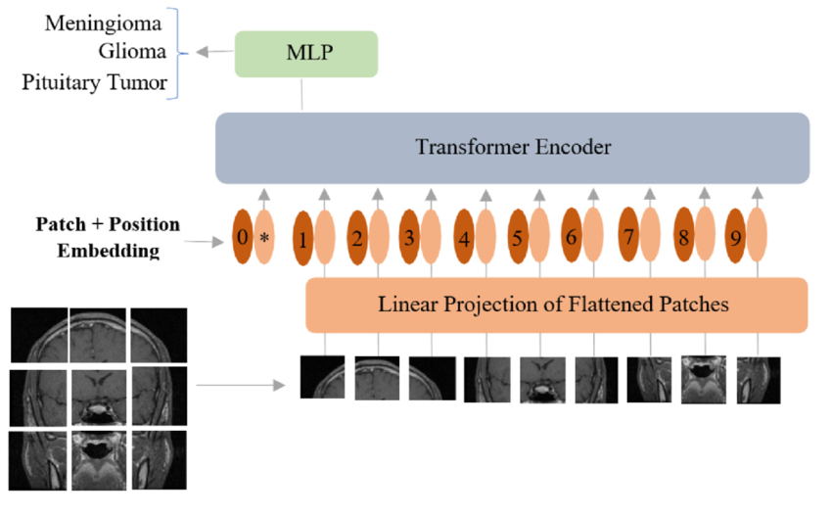
Vision Transformer (ViT)
The ViT is Used for image classification, detection, and segmentation, capturing local and global details. It’s also a backbone for multi-scale feature extraction in tasks like camouflaged object detection and image restoration.
ViT Process:
Patch Processing: Divides the image into patches, embeds each into a fixed-size vector.
Positional Encoding: Adds spatial information to patch embeddings.
Self-Attention Mechanism: Uses transformer layers to capture long-range dependencies.
Multi-Scale Feature Extraction: Processes patches at various resolutions to capture detailed features.
Notes:
The Vision Transformer, or ViT, is crucial for our model because it serves as the backbone, enabling powerful multi-scale feature extraction. It excels in image classification, detection, and segmentation by capturing both local and global details, making it ideal for tasks like camouflaged object detection and image restoration.
Here’s a quick overview of the ViT Process:
Patch Processing: The image is divided into patches, with each patch embedded into a fixed-size vector, allowing the transformer to process the image in manageable parts.
Positional Encoding: Spatial information is added to these patch embeddings, helping the model understand the layout and structure of the image.
Self-Attention Mechanism: The transformer layers use self-attention to capture long-range dependencies, enabling the model to understand relationships across the entire image.
Multi-Scale Feature Extraction: By processing patches at various resolutions, the ViT extracts detailed features across different scales, which is key to the model's ability to handle diverse and complex visual tasks.
Vision Transformer (ViT) Process Explanation:
Image Patch Division:
What Happens: The input image is divided into fixed-size patches (e.g., 16x16 pixels).
Why: This division allows the image to be treated as a sequence of smaller, manageable pieces, similar to how text is treated as a sequence of words in NLP.
Patch Embedding:
What Happens: Each image patch is flattened into a 1D vector and then linearly transformed into a fixed-size embedding vector using a trainable linear projection.
Why: This step converts the image patches into a format that can be processed by the transformer model, with each patch becoming a token in the sequence.
Positional Encoding:
What Happens: Positional encodings are added to each patch embedding to retain the spatial information of the patches within the image.
Why: Transformers do not inherently capture positional information since they are permutation-invariant. Positional encodings help the model understand the order and position of patches in the original image.
Transformer Encoder Layers:
What Happens: The sequence of patch embeddings is passed through multiple transformer encoder layers. Each encoder layer has two main components:
Multi-Head Self-Attention (MHSA): Each patch embedding attends to all other patches, allowing the model to capture relationships between different parts of the image. Multiple attention heads allow the model to focus on different aspects of the relationships.
MLP (Multi-Layer Perceptron): After attention, the output is passed through a small feedforward neural network, typically consisting of two fully connected layers with a non-linear activation function (like GELU) in between.
Why: The self-attention mechanism enables the model to consider the global context of the image, not just local features, which is crucial for understanding complex patterns. The MLP helps in further processing and transforming the information for downstream tasks.
Multi-Scale Feature Extraction:
What Happens: While not an explicit step in the original ViT, multi-scale feature extraction can be achieved by processing patches at different resolutions or by integrating the ViT with feature fusion techniques that combine outputs from different transformer layers.
Why: Extracting features at multiple scales is important for capturing both fine details and broader patterns in the image, which are essential for tasks like segmentation and object detection.
Classification Token (if used):
What Happens: In many ViT models, a special classification token (CLS token) is added to the sequence of patches before they enter the transformer layers. The final output of this token after passing through the transformer layers is used for classification.
Why: The CLS token aggregates information from all patches, providing a global representation of the image that can be used for tasks like classification.
Final Output:
What Happens: The output from the transformer layers (either the CLS token or the entire sequence) is passed to a final classification layer or used for other tasks like segmentation.
Why: This step produces the final predictions or outputs based on the processed and transformed information from the image patches.

Slide 9
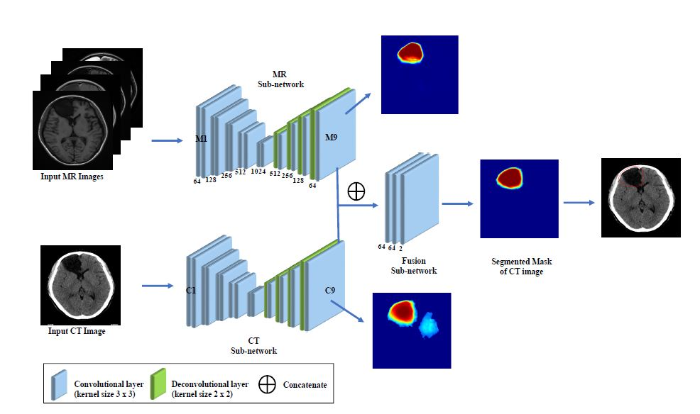
Feature Fusion (FF)
Multi-Scale Integration: The FF module merges features from different scales, capturing fine details and broader patterns, enriching the image representation.
Dynamic Weight Adjustment: During training, the module learns to prioritize key features with dynamic weights, often using attention mechanisms to improve focus.
Enhanced Image Processing: By combining multi-scale features, the FF module refines and improves image outputs, especially in tasks like restoration, segmentation and detection.
Notes:
In this slide, we will focusing on the Feature Fusion (FF) module, which plays a critical role in our model by integrating inputs from the Vision Transformer (ViT).
Multi-Scale Integration: The FF module merges features extracted by the ViT from different scales, effectively capturing both fine details and broader patterns. This enriches the overall image representation, making it more robust for further processing.
Dynamic Weight Adjustment: During training, the FF module dynamically adjusts the weights of different features. We're interested in modifying this weight adjustment process in the future, to better handle various types of noise that imitate image damage. By doing so, we aim to make the model more resilient to the kinds of distortions that can occur in real-world scenarios.
Enhanced Image Processing: By combining these multi-scale features, the FF module significantly refines and improves image outputs, which is especially important for tasks like restoration.

Slide 10
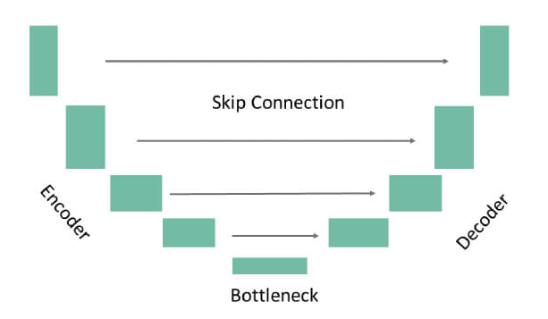
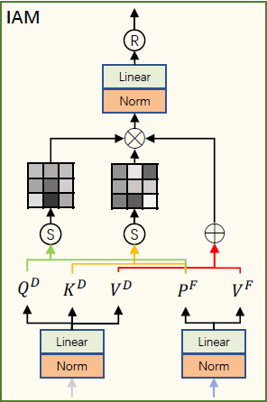
Denoising U-Net & IAM
Encoder: Downsamples the input, extracting multi-scale features while preserving essential information, reducing spatial dimensions progressively.
IAM in the Bottleneck: Integrated into U-Net's bottleneck, enhancing feature refinement by focusing on critical textures, guiding effective denoising.
Decoder: Upsamples encoded features to reconstruct the image, using transposed convolutions to restore resolution with a focus on detail.
Skip Connections: Link encoder and decoder layers, retaining high-resolution features to preserve fine details in the denoised output.
Notes:
In this slide, we’ll see the Denoising U-Net architecture with emphasis on the Injection Attention Module (IAM) and how it plays a crucial role in the reverse diffusion process.
We begin with the Encoder, which is responsible for downsampling the input image. During this process, the encoder extracts multi-scale features, progressively reducing the spatial dimensions while still preserving essential information. These features are key to capturing different levels of detail that the model will use in the reconstruction phase.
Now, let's focus on the IAM in the Bottleneck. The IAM, or Injection Attention Module, is positioned at the bottleneck of the U-Net and plays a crucial role in refining the features used for denoising. What makes the IAM powerful is its ability to integrate feature maps from two key sources: the noisy image processed by the encoder and the original image features provided by the Feature Fusion model.
The Feature Fusion model extracts features from the original, non-noisy image. These features are then fed into the IAM alongside the multi-scale features from the noisy image. The IAM uses attention mechanisms to assess these combined inputs, determining which areas of the image are most critical for accurate denoising. By focusing on these crucial textures and structures, the IAM guides the model to prioritize them during the reverse process, effectively restoring the image with greater precision.
After the IAM refines these features, the Decoder begins the reverse process, upsampling the enhanced features to reconstruct the image. Using transposed convolutions, the decoder restores the resolution, ensuring that the final output is as close to the original image as possible, with an emphasis on the fine details identified by the IAM.
The IAM takes two inputs: the multi-scale fusion feature F from the Feature Fusion (FF) module and the deepest feature D from the diffusion model.
These inputs undergo the following process:
Feature Transformation The deepest feature D is linearly projected to produce the query $Q_{D}$​, key $K_{D}$​, and value $V_{D}$​. The fusion feature F is linearly projected to generate $P_{F}$​, and $V_{F}$​​. Unlike typical attention mechanisms, F does not generate queries and keys for direct similarity comparison, instead, it uses $P_{F}$​, ​ for this purpose. Those are formulated by:
$Q_{D}=D⋅W_{D}^{Q}$ - The query matrix derived from the deepest feature D.
$K_{D}=D⋅W_{D}^{K}$ - The key matrix derived from the deepest feature D.
$V_{D}=D⋅W_{D}^{V}$ - The value matrix derived from the deepest feature D.
$P_{F}=F⋅W_{F}^{P}$ - The intermediary projection of F, used for similarity comparison.
$V_{F}=F⋅W_{F}^{V}$ - The value matrix derived from the fusion feature F.
Where $W_{D}^{Q}, W_{D}^{K}, W_{D}^{V}, W_{F}^{P}, W_{F}^{V}$ are the learned projection matrices, and d is the dimensionality of these projections.
similarity Computation
The similarity between the query $Q_{D}$​ and the intermediary projection $P_{F}$​ is as computed as followed:
$$M_{1}^{att}=Softmax\left(\frac{Q_{D}⋅P_{F}^{T}}{\sqrt{d}}\right)$$
Similarly, the similarity between the key $K_{D}$​ and the intermediary projection $P_{F}$​ is computed:
$$M_{2}^{att}=Softmax\left(\frac{K_{D}⋅P_{F}^{T}}{\sqrt{d}}\right)$$
These similarity scores are normalized using the SoftMax function, resulting in attention maps $M_{1}^{att}$​ and $M_{2}^{att}$ ​(Attention maps are a core component of the attention mechanism in machine learning models, especially in tasks like image processing and natural language processing. They help the model understand which parts of the input data are most important for making accurate predictions or decisions).
Attention Weight Application The weighted values are combined to form the final output:
$$O_{I}=M_{1}^{att}⋅M_{2}^{att}⋅\left(V_{D}+V_{F}\right)$$
The output feature map $O_{I}$ serves as a refined representation that combines the strengths of both the multi-scale fusion features and the deep diffusion features. By leveraging cross-attention, $O_{I}$ effectively integrates texture and localization information, making it highly effective for tasks that require detailed and context-aware feature representations.

Slide 11



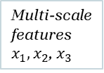
Model’s Process
Dynamic weight adjustment
Input Image
ViT – image processing
Multi-scale features$x_{1},x_{2}$, $x_{3}$
FF – feature extraction
$$x_{0}$$
$$x_{0}$$
Feature Map F
Noise addition
Denoising U-Net Encoder – Extract deepest features
IAM – guide diffusion process
Denoising U-Net Decoder – Produce Refined version
Restored Image
$$y_{t}$$
Feature Map D
Feature Map O
Salt-and-Pepper Noise
$$y_{t−1}$$
Notes:
This slide illustrates the overall flow of our model, which we've discussed in detail earlier.
We start with the Input Image, which is first processed by the ViT (Vision Transformer) to extract multi-scale features. These features are then passed to the Feature Fusion (FF) module, which integrates them and applies Dynamic Weight Adjustment to prioritize key features.
Now Hagar will continue with the next steps of the flow:Simultaneously, noise is added to the input image to simulate degradation, producing a noisy image. The Denoising U-Net Encoder then extracts the deepest features from this noisy image. These features, along with the refined features from the FF module, are fed into the IAM (Injection Attention Module) to guide the diffusion process, focusing on reversing the noise.Finally, the Denoising U-Net Decoder takes the output from the IAM to reconstruct the image, resulting in the Restored Image.

Slide 12
Model’s Process
Dynamic weight adjustment
Input Image
ViT – image processing
Multi-scale features$x_{1},x_{2}$, $x_{3}$
FF – feature extraction
$$x_{0}$$
$$x_{0}$$
Feature Map F
Noise addition
Denoising U-Net Encoder – Extract deepest features
IAM – guide diffusion process
Denoising U-Net Decoder – Produce Refined version
Restored Image
$$y_{t}$$
Feature Map D
Feature Map O
Salt-and-Pepper Noise
$$y_{t−1}$$
Notes:
Noise is added to the input image to simulate degradation, creating a noisy version. The U-Net Encoder extracts deep features from this image, which, combined with refined features from the FF module, are fed into the IAM to guide noise reversal. The U-Net Decoder then reconstructs the image, producing the restored result.

Slide 13
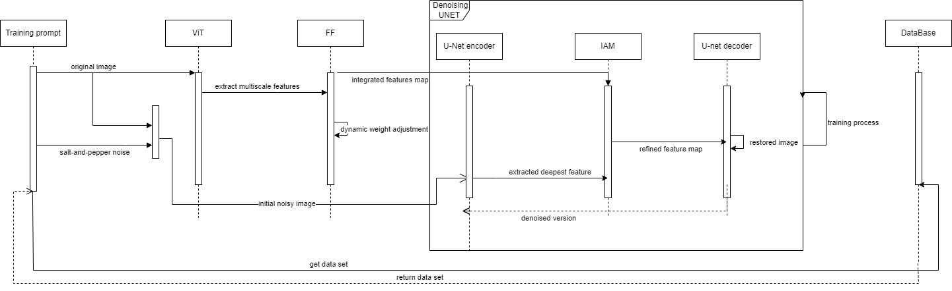
Sequence

Slide 14
Testing plan
Module | Test Description | Expected result
Input Preprocessing | Test the ability to handle batch processing of images. | The system processes batches of 100 images within a short timeframe, maintaining consistent quality across all outputs.
Feature Extraction | Verify extraction of relevant features from noisy images across multiple scales (resolution) | Extracted feature maps consistently capture essential details, with feature detection accuracy exceeding 90% across all scales.
Denoising and Reverse Process | Validate ability to remove noise and restore images to near-original state. | Denoised images achieve PSNR values of at least 30 dB, indicating effective noise removal.
Injection Attention Module (IAM) | Ensure integration of semantic features to refine and enhance restoration. | Improved image quality is evidenced by a 10% increase in SSIM, confirming the IAM's enhancement capabilities.
Output Module | Confirm final output images meet quality standards in sharpness and clarity. | Restored images achieve SSIM scores above 0.85 and PSNR values above 30 dB, indicating high-quality restoration.
 | Evaluate performance with edge cases, such as very high or low-resolution images. | High-resolution images maintain SSIM above 0.8, while low-resolution images achieve at least a 0.75 SSIM.
Notes:
This table outlines the testing framework for various modules involved in an image restoration process using diffusion models. 3. Denoising and Reverse Process:Validates the system's capability to remove noise and restore images to a near-original state, achieving a Peak Signal-to-Noise Ratio (PSNR) of at least 30 dB. PSNR, or Peak Signal-to-Noise Ratio, is a metric used to measure the quality of a reconstructed or compressed image (or video) compared to its original version.
4. Injection Attention Module (IAM): Ensures the integration of semantic features (the most importance feature that need to be focus in the restoration process) to enhance image restoration, confirmed by a 10% increase in Structural Similarity Index (SSIM).
SSIM (Structural Similarity Index Measure) is a metric used to evaluate the similarity between two images, particularly their structural details, and it is widely used for assessing the quality of images in tasks like image compression, denoising, and reconstruction.
5. Output Module: - Confirms that the final restored images meet quality standards for sharpness and clarity, with SSIM scores above 0.85 and PSNR values above 30 dB.
- Evaluates the system's performance on edge cases, such as very high or low-resolution images, maintaining a minimum SSIM score for both scenarios.

Slide 15
Thank you for listening

